Slide 1

COMP 790-136: Getting Started
Topics: People and Course Overview

Slide 2
People
Let’s introduce ourselves!
Your name
What major/research area/Advisor
An interesting project that you did recently

Slide 3


Two-fold Learning Objective
Learning (through recent research papers) the advances in Mobile Computing Systems and Embedded Machine Learning.
Gaining practical experience with programming mobile devices, e.g., Android smartphones.

Slide 4



What to Expect
A lot of reading and self-learning.
Recharging your creativity.

Slide 5





Course Structure
Lecture/
Presentation
Class
Activity
Paper
Assignment
Programming
Assignment
Midterm
Final

Slide 6
A Typical Class – Tuesday (Android)
Upload pending activities (e.g., last week’s lab) before the class.
Programming
Lecture
Programming
Practice
Try to finish the lab work in class.

Slide 7
A Typical Class – Thursday (Papers)
Paper
Assignment
Paper
Presentation
Class
Activity
Upload synopsis before the class begins
Presenter(s) present, others participate in the discussion and debate.

Slide 8

Grading
Class Activity (10%)
Programming Labs (20%)
Paper Synopsis (20%)
Paper Presentation (20%)
Midterm Exam (15%)
Final Exam (15%)

Slide 9
Office Hours and Resources
Office Hour: After/before class (Email in advance)
TA: TBD (2-3 classes)
Course Webpage: https://eisys.web.unc.edu/
Sakai: Assignments and project.
[GitHub: https://github.com/uncmobile]
Are you getting emails?

Slide 10
Some Logistics
Absence
Late Assignments
Office/TA Visit
Class Etiquette

Slide 11
Course Content
Research Papers:
Mobile Sensing and Embedded Machine Learning
MobiCom/MobiSys/SenSys/IPSN/HotMobile/etc.
Programming Lab:
Android – Framework, Intent, Layouts, Events
Sensors – Camera, Location, and a dozen more!
Animation and Drawing
Machine Learning – On-device, Web Service.

Slide 12

Example Project
https://www.youtube.com/watch?v=wSSlwtED2Yg

Slide 13
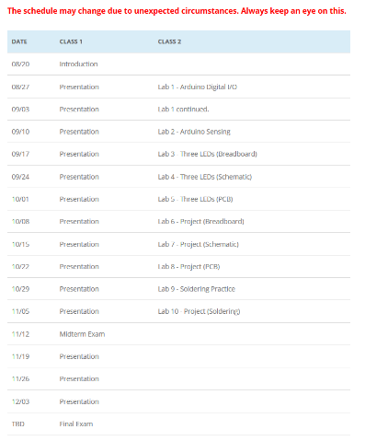
Schedule
Schedule (Always Check the Course Webpage)

Slide 14
Next Steps
Drop the course by next class if you are going to.
Lab Class:
The goal is to make sure everyone is ready with their Android development environment.
Install Android Studio
Try a “Hello World” program by yourself.
We will learn to build our first App.

